Slide 1

UNIVERSITY INSTITUTE OF ENGINEERING
COMPUTER SCIENCE ENGINEERING
Bachelor of Engineering (Computer Science & Engineering)
Subject Name: Big Data Analytics
Subject Code: 20CST-471
Introduction to NoSQL databases
Mapped with CO2
Prepared By:
Er. Ankita Sharma
DISCOVER . LEARN . EMPOWER

Slide 2
Introduction to NoSQL databases
NoSQL databases represent a revolutionary departure from traditional relational database management systems, providing a flexible and scalable alternative to handle the burgeoning volumes and diverse structures of modern data.
The term "NoSQL" stands for "Not Only SQL," emphasizing the departure from the rigid tabular structures and SQL query language associated with traditional databases.

Slide 3
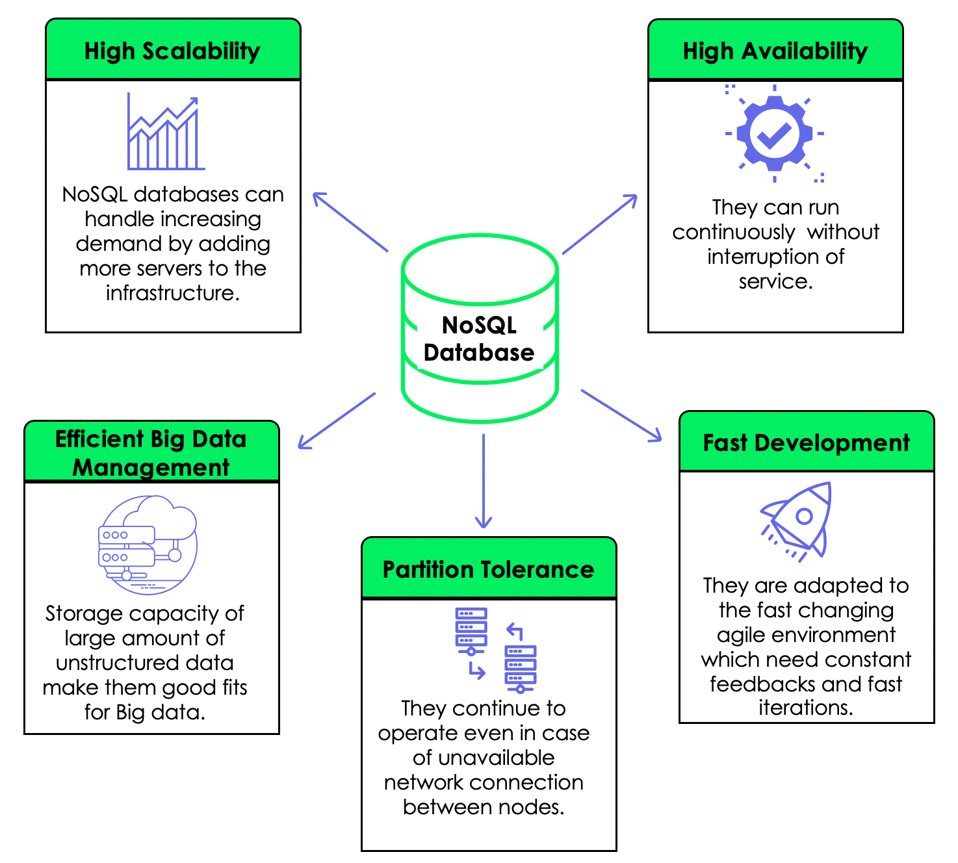

Slide 4
NoSQL databases are designed to accommodate various data types, including unstructured and semi-structured data, offering a dynamic and schema-less approach to data storage.
One of the key characteristics of NoSQL databases is their ability to scale horizontally, allowing them to efficiently handle large amounts of data across distributed and often commodity hardware. Unlike relational databases,
NoSQL databases do not adhere to a fixed schema, enabling developers to adapt and evolve data models on-the-fly to meet changing application requirements.

Slide 5
This flexibility is particularly advantageous in the context of rapidly evolving web applications, real-time analytics, and other scenarios where data structures are subject to frequent changes.
NoSQL databases are categorized into several types, each tailored to specific use cases:
Document-oriented databases (e.g., MongoDB), Column-family databases (e.g., Apache Cassandra), Key-value stores (e.g., Redis), and Graph databases (e.g., Neo4j).

Slide 6
Each type addresses different aspects of data storage and retrieval, offering unique features that cater to the diverse needs of modern applications.
As organizations grapple with the challenges of big data and dynamic data requirements, NoSQL databases have become instrumental in providing scalable, flexible, and efficient solutions for data management.

Slide 7
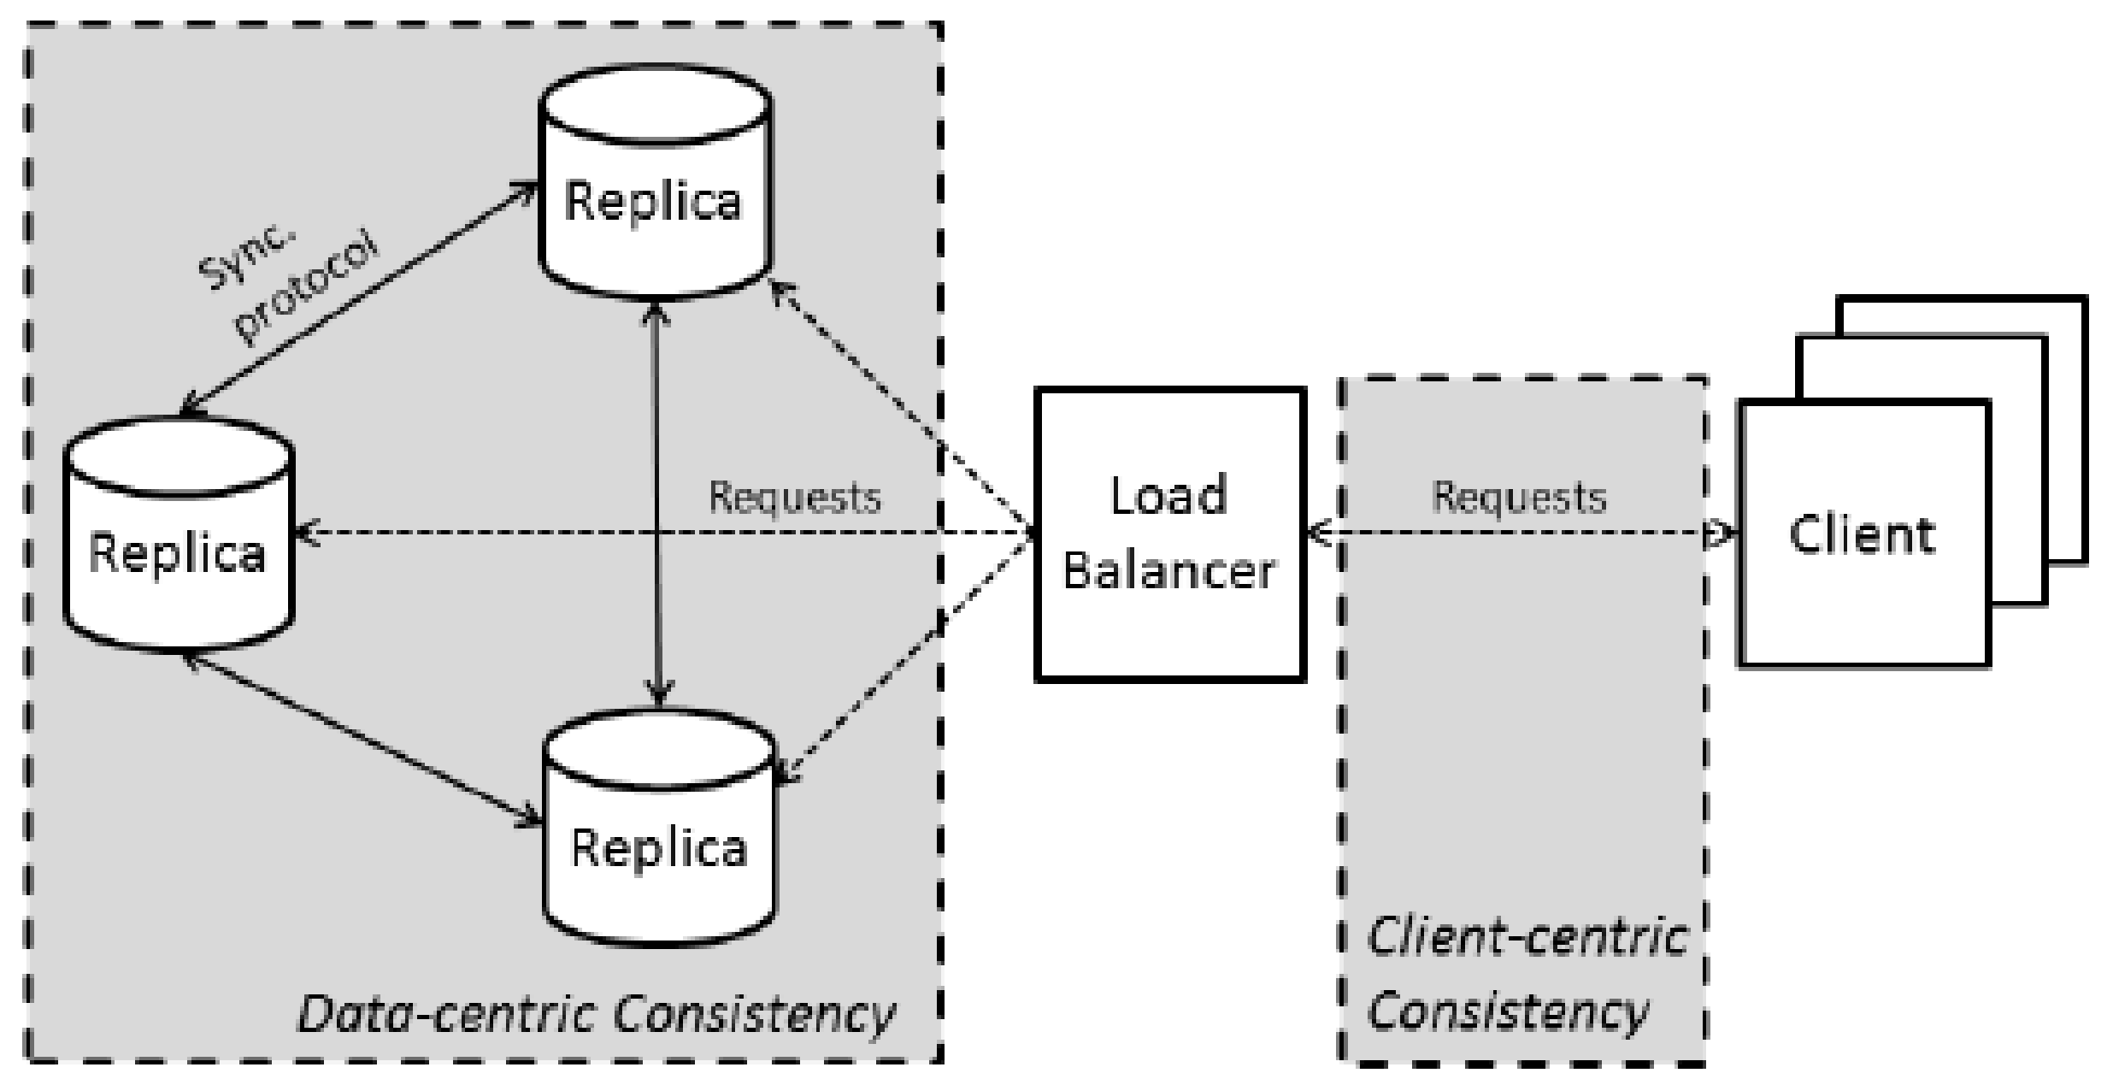

Slide 8
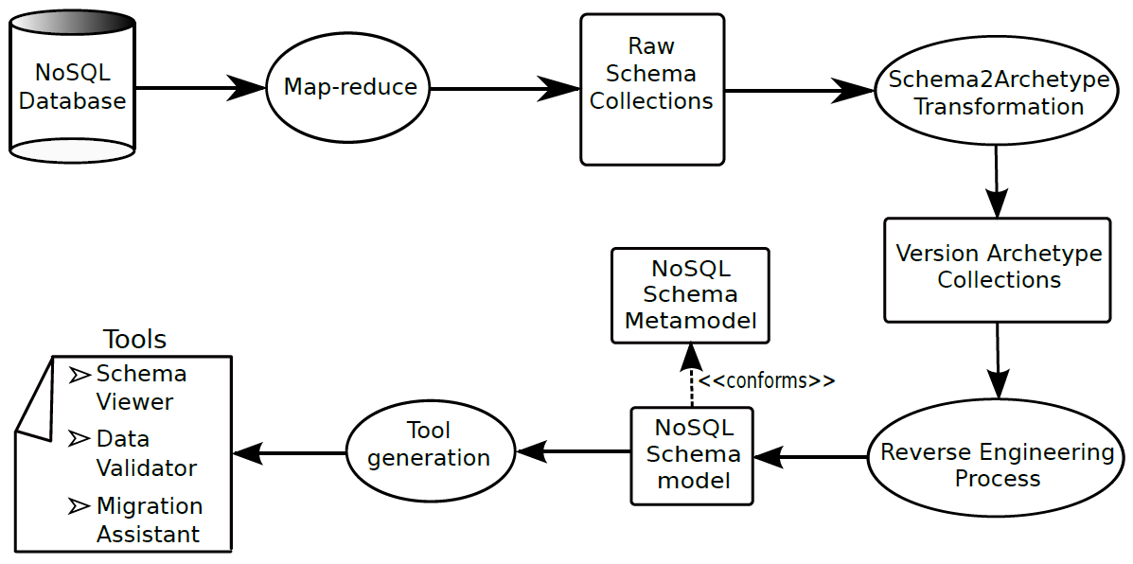

Slide 9
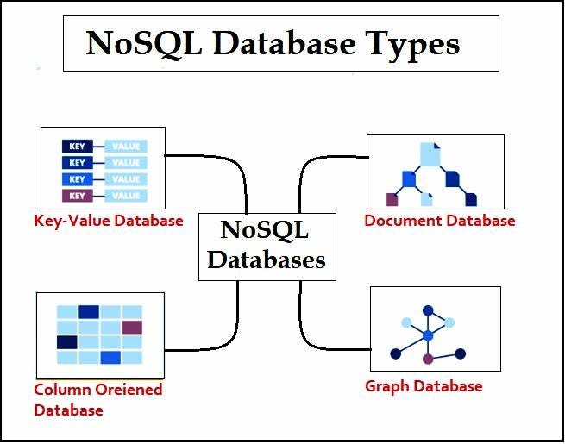

Slide 10
Thankyou

